Slide 1
Pipelining: Basic and Intermediate Concepts Appendix C
Basics of Pipelining
Implementation of Pipeline
Hazards and their Solutions
Exception Handling
Pipeline with Floating-Point Instructions
Dynamic Scheduling of Pipelines

Slide 2

Pipeline Hazards
Branch Hazards
Causes more performance loss than data hazards
Taken or untaken branches
Fall through and content of PC
Reducing Pipeline Branch Penalties
Four simple compile time schemes, where predictions are static
Compile time guesses
Static
Fixed for each branch during the entire execution
Freeze the pipeline
Simplest
Hold all instructions after the branch until the branch direction is known

Slide 3
Pipeline Hazards
Predict the branch as not taken and allow the pipeline to continue
Do not change the machine state until the branch outcome is definitely known
Predict the branch as taken
Begin fetching and executing at the target as soon as the target address is computed
The simple pipeline of RISC-V has the same penalty for all three situations
These schemes make more sense in machines with deeper pipeline
Use delayed branch technique
Used in many early RISC processors
Works well in simpler pipelines

Slide 4
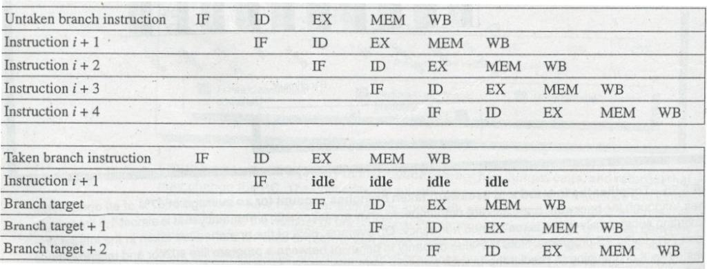
The predict-not-taken scheme
Branch not taken
Branch taken

Slide 5
Pipeline Hazards
The execution cycle with a branch delay of length 1 is
Branch instruction
Sequential successor1
Branch target if taken
Sequential successor is in the branch delay slot
This instruction is always executed
Job of the compiler is to make the successor instruction valid and useful
Delayed branch technique is useful for simple pipelines where hardware prediction was too expensive
Technique complicates implementation when there is dynamic branch prediction

Slide 6
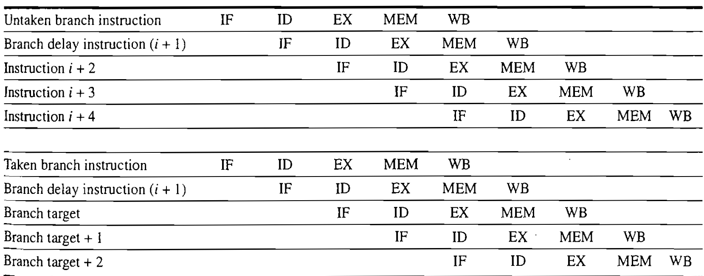
Behavior of a delayed branch scheme

Slide 7
Pipeline Hazards
Performance of Branch Schemes
Pipeline Speedup =
Pipeline depth
1 + Pipeline stall cycles from branches
Pipeline Speedup =
Pipeline depth
1 + Branch frequency * Branch penalty
Both conditional and unconditional branch contribute to the stalls

Slide 8
Reduce Cost of Branches through Prediction
With the increase in the pipeline depth
Branch penalty increases
Delayed branch schemes are not sufficient
More aggressive means of predicting branches
Two classes
Low-cost static schemes
Relies on information available at compile time
Predict branches dynamically
Static Branch Prediction
Use profile information from earlier runs
Misprediction rate is higher for integer programs as compared to floating-point programs

Slide 9
Principles of Pipelining
How is Pipelining Implemented?
Implementation of RISC-V without pipelining
A Simple Implementation of RISC-V
Every instruction takes at most 5-cycles
1. Instruction Fetch Cycle (IF)
IR ← Mem [PC]
NPC ← PC + 4 NPC: Next Sequential Instruction
2. Instruction Decode/Register Fetch Cycle (ID)
A ← Regs [rs1]
B ← Regs [rs2]
Imm ← sign-extended immediate field of IR
Imm, A and B are temporary registers
Fixed-field decoding is done

Slide 10
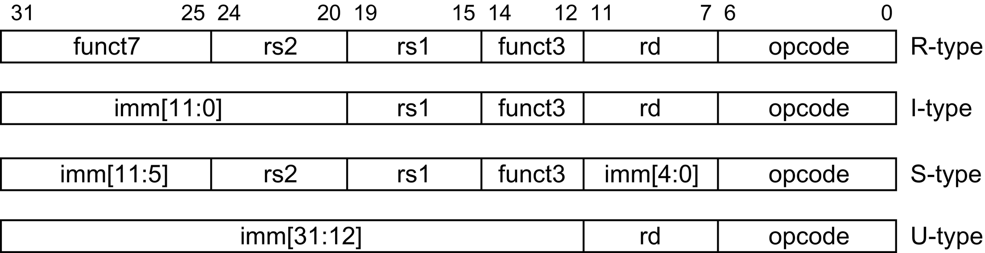
Instruction layout for RISC-V
Four major types of instructions

Slide 11
A Simple Implementation of RISC-V
Execution/Effective Address Cycle (EX)
Only one of following four functions is performed depending on the type of instruction
Memory Reference Instruction
ALU_{output} ← A + Imm
Register-Register ALU Operation
ALU_{output} ← A func B
Register-Immediate ALU Operation
ALU_{output} ← A op Imm
Branch Operation
ALU_{output} ← NPC + (Imm<<2);
Cond ← (A == B) (Only BEQ is considered)

Slide 12
A Simple Implementation of RISC-V
4. Memory access/branch completion cycle (MEM)
PC is updated for all instructions
PC ← NPC;
For load, store and branch instructions
For Memory Reference instructions
LMD ← Mem[ALU_{output}] OR Mem[ALU_{output}] ← B
For Branch instructions
If (cond) PC ← ALU_{output}
5. Write-Back Cycle (WB)
Register-Register or Register-Immediate ALU Instructions
Regs[rd] ← ALU_{output}
Load Instruction
Regs[rd] ← LMD

Slide 13
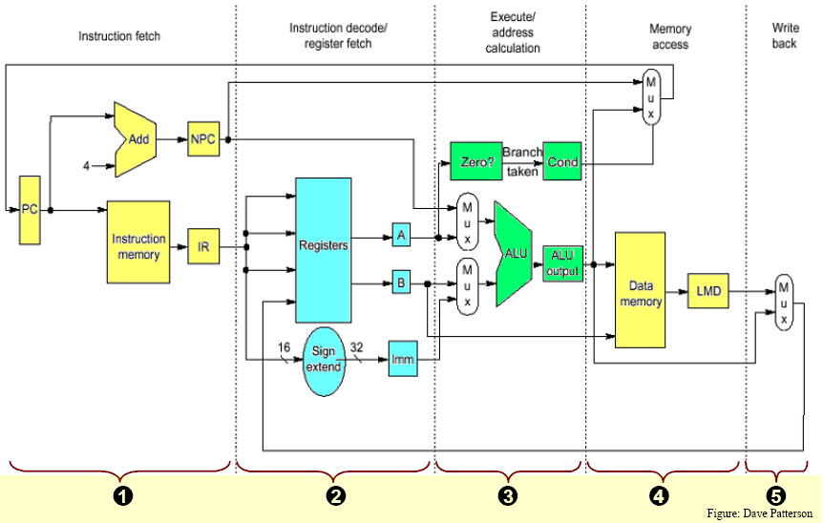
RISC-V data path allows every instruction to be executed in 4 or 5 clock cycles
=?
12

Slide 14
A Simple Implementation of RISC-V
At the end of each clock cycle every value that is computed is written into a storage device
LMD, Imm, A, B, IR, etc.
The temporary registers hold values between clock cycles
Hardware Redundancies
Two ALUs can be merged as one
Data and instructions can be stored in the same memory
Design provides a better base for pipelined implementation

Slide 15
Implementation of Pipelining
A Basic Pipeline for RISC-V
Pipeline the data path with almost no changes
Pipeline registers or pipeline latches pass the values from one pipe stage to another
All information for an instruction required for its correct execution is submitted in these registers
Contains both data and control information
Events on every pipe stage of the RISC-V pipeline
Operations in the first two stages are independent of the current instruction

Slide 16
Pipelined data path after adding a set of registers, one between each pair of pipe stages
Instruction
Fetch
Instr. Decode
Reg. Fetch
Execute
Addr. Calc
Memory
Access
Write
Back
Next PC
IF/ID
ID/EX
EX/MEM
MUX
MEM/WB
Next SEQ PC
Next SEQ PC
Adder
Zero?
4
=?
RS1
Reg File
PC
MUX
Memory
RS2
ALU
Data
Memory
MUX
MUX
Sign
Extend
Imm
WB Data
RD
RD
RD

Slide 17
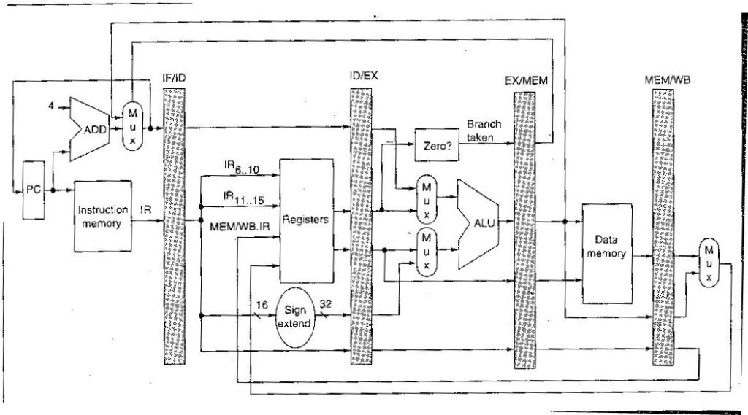
Data path is pipelined by adding a set of pipeline registers
=?

Slide 18
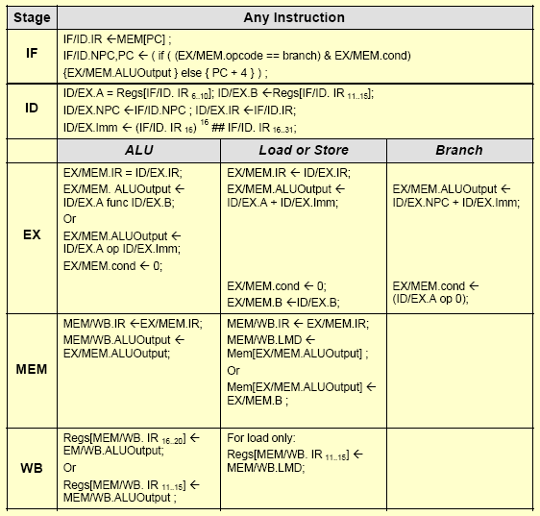
Events on every pipe stage of the RISC-V pipeline

Slide 19
Implementation of Pipelining
Controls for the four multiplexers
Top MUX of ALU
Set by whether an instruction is a branch or not
Bottom MUX of ALU
Set by whether the instruction is a register- register ALU or any other type of operation
IF or MEM stage MUX
Chooses between the incremented PC or the branch target address
WB stage MUX
Chooses between whether the instruction in WB is a Load or an ALU instruction
Implementing the Control for the RISC-V Pipeline

Slide 20
Implementation of Pipelining
Instruction Issue: The process of letting an instruction move from ID to EX stage
All data hazards are checked in ID stage
Decision to stall the pipeline or forwarding operation is taken in this stage
Detecting interlocks early in the pipeline is easier and it reduces hardware complexity
A number of tests are performed in ID stage
A number of fields are tested
Forwarding logic and the comparisons done when the destination of the forwarded result is the ALU input (for the instruction currently in EX)
Enlarge the multiplexers needed at the ALU input to accommodate additional logic

Slide 21
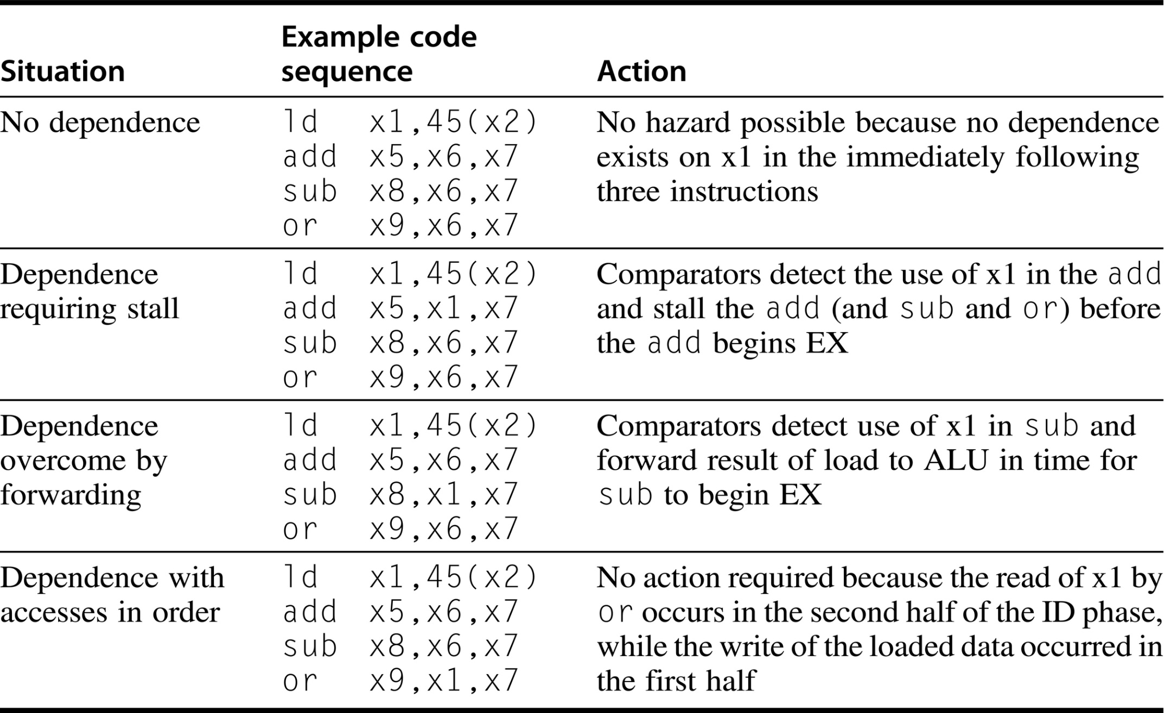
Situations that the pipeline hazard detection hardware can see by comparing the destination and sources of adjacent instructions

Slide 22
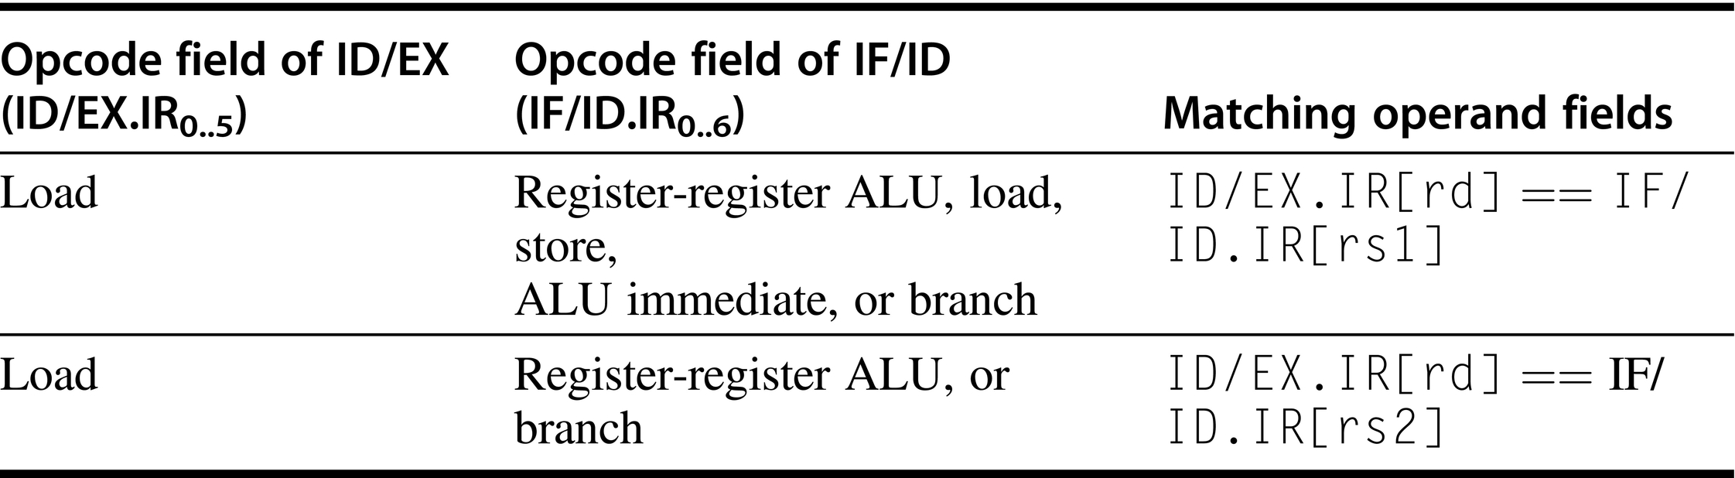
Logic to detect the need for load interlocks in ID stage - Requires two comparisons

Slide 23
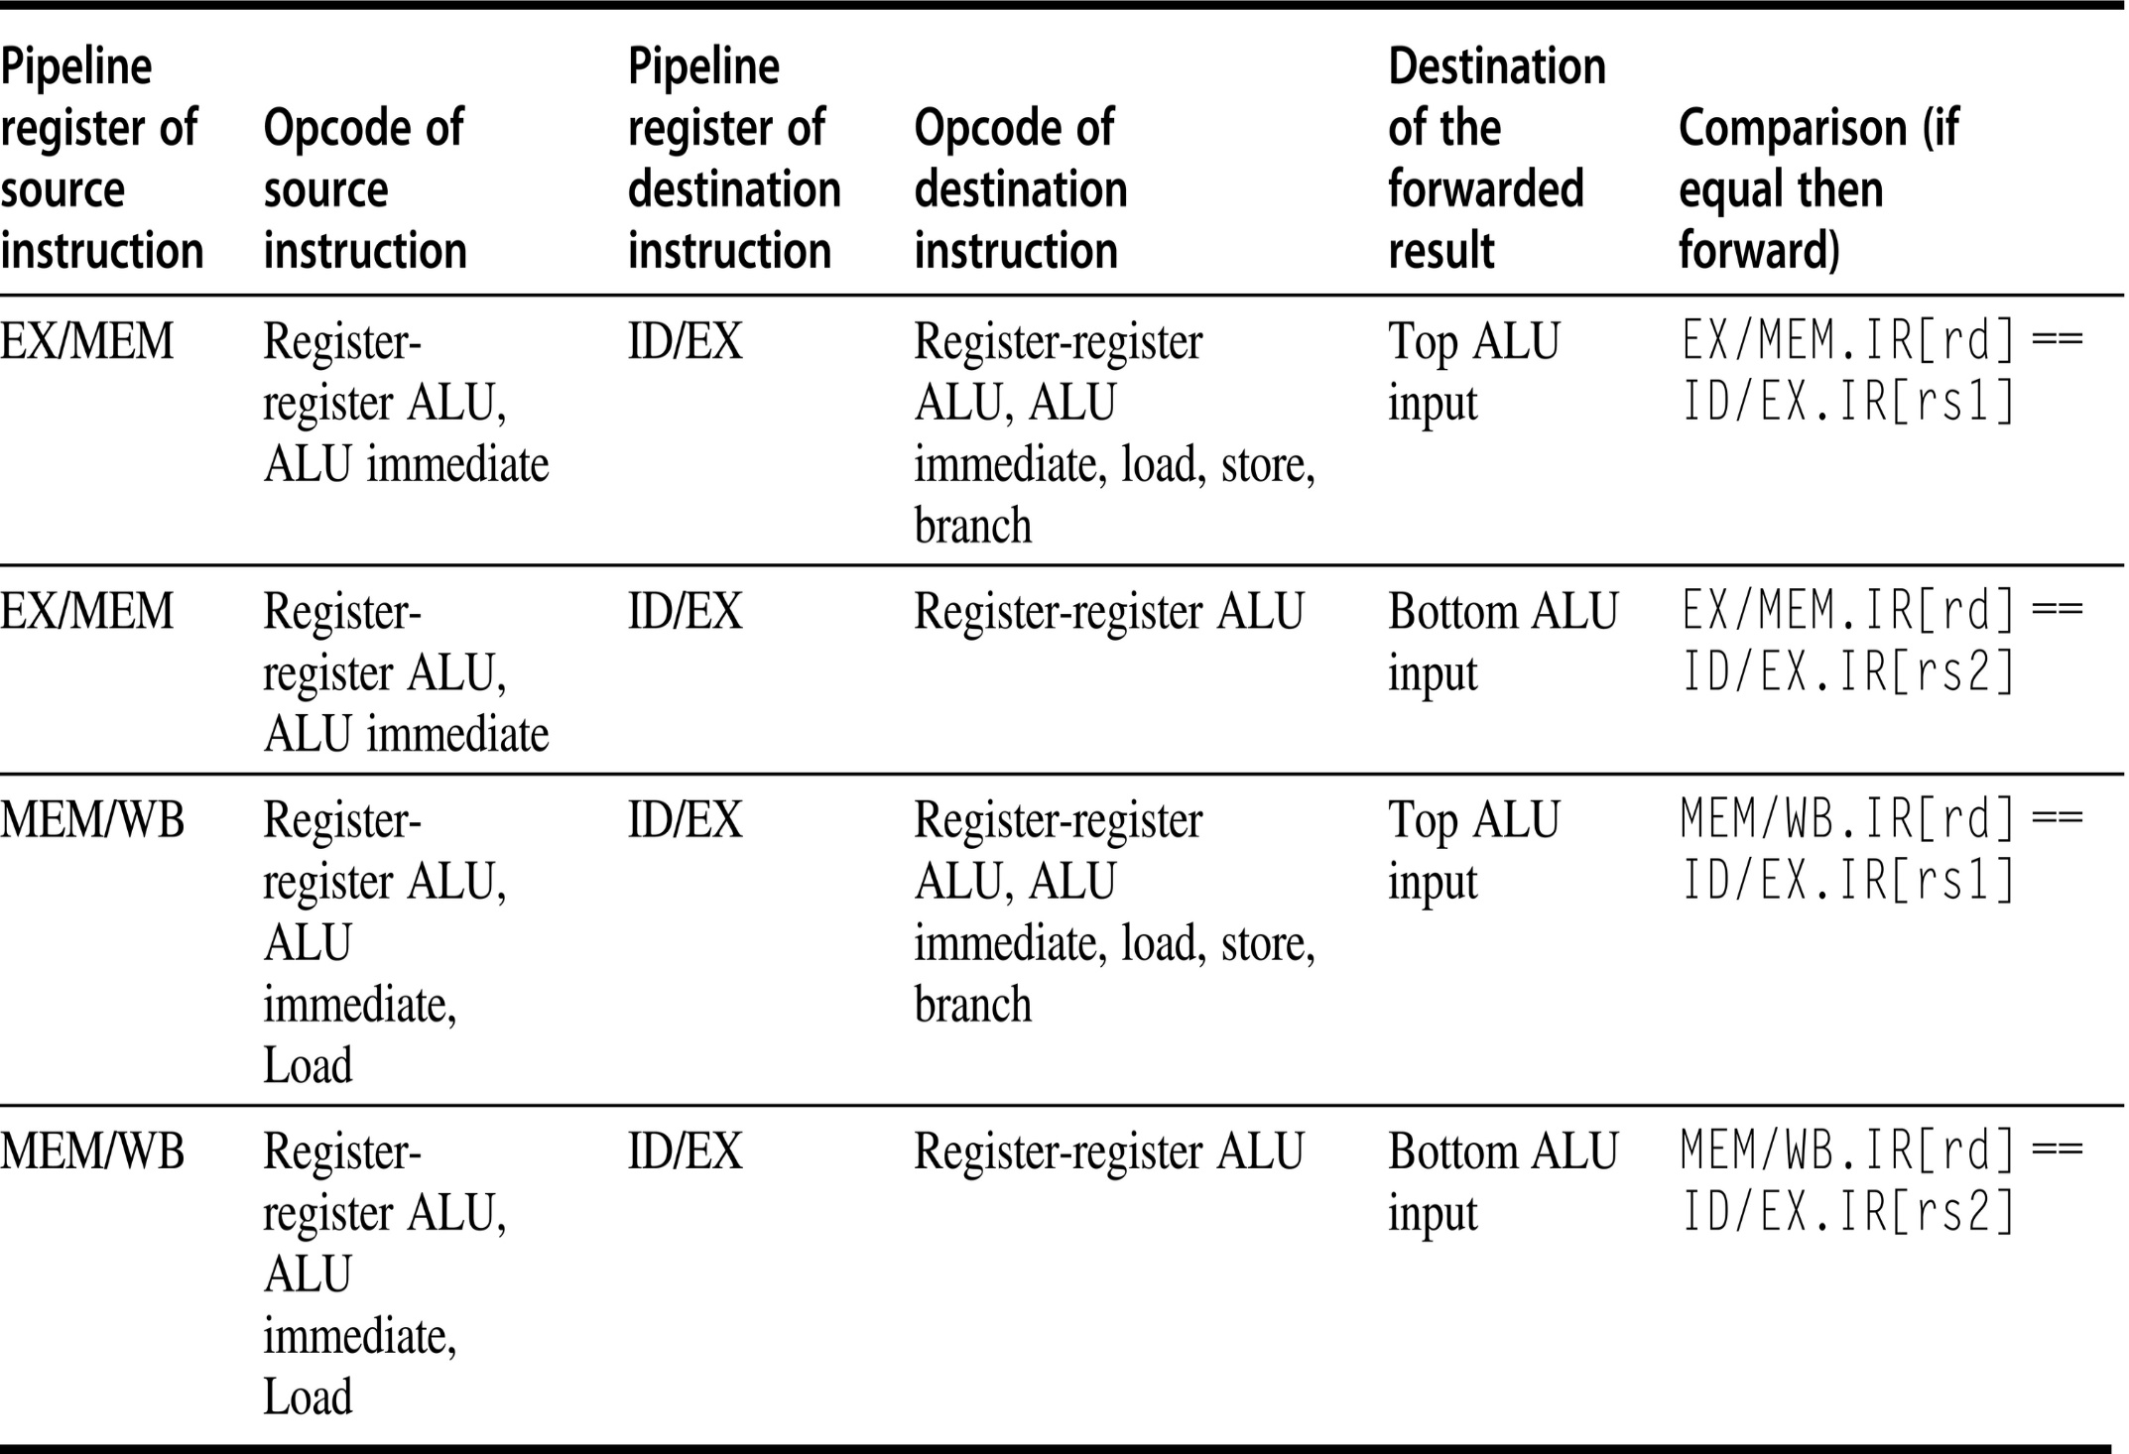
Forwarding of data to the two ALU inputs

Slide 24
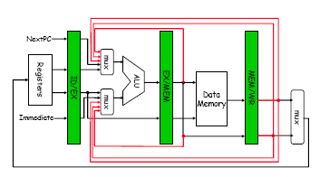
Forwarding of results to ALU adds three extra inputs to ALU MUXes

Slide 25
Hardware Changes for Forwarding
NextPC
ID/EX
EX/MEM
MEM/WR
mux
Registers
ALU
Data
Memory
mux
mux
Immediate

Slide 26
Implementation of Pipelining
Hazard detection and forwarding hardware is simple in RISC-V
Floating-point instructions are not included
Dealing with Branches in the Pipeline
Revised pipelined data path where branch is completed in the EX cycle
Additional ALU is required in ID stage
The branch penalty is now 2 cycles
With the increase in pipeline depth, branch penalty increases
Dynamic branch prediction is becoming more important and necessary

Slide 27
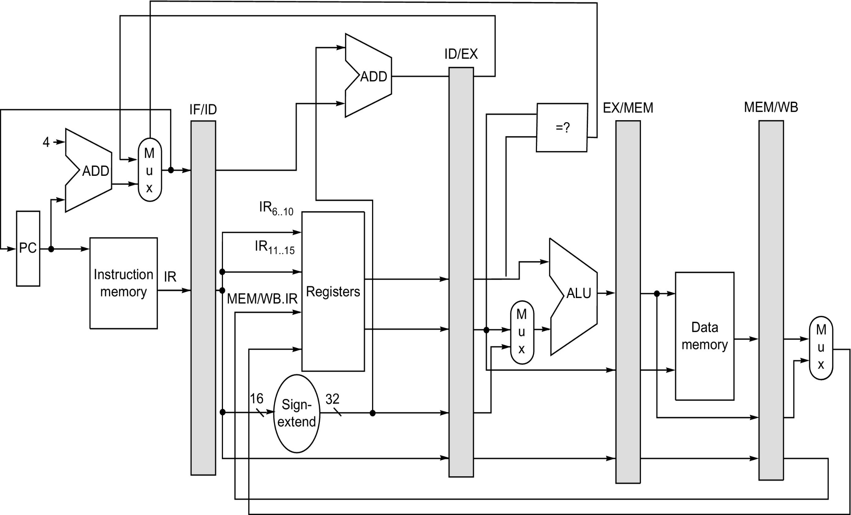
Revised pipeline data path

Slide 28
What Makes Pipelining Hard to Implement?
Exceptions: When the instruction order is changed in unexpected ways
Challenges raised by different instruction sets
Dealing with Exceptions
Overlapped execution of instructions make exception handling more difficult to implement
Types of Exceptions and Requirements
I/O device request
Invoking an OS system service from a user program
Tracing instruction execution
Breakpoint (programmer requested interrupt)
Integer arithmetic overflow
FP arithmetic anomaly
Page fault

Slide 29
What Makes Pipelining Hard to Implement?
Misaligned memory access
Memory protection violation
Using an undefined or unimplemented instruction
Hardware malfunctions
Power failure
Names of common exceptions vary among different architectures
The requirements on exceptions can be characterized on five semi-independent axes
Synchronous versus asynchronous
If the event occurs at the same place every time the program is executed with the same data and memory allocation, it is said to be synchronous

Slide 30
What Makes Pipelining Hard to Implement?
Asynchronous events are caused by devices external to the processor and memory (except hardware malfunction)
User requested versus coerced
User maskable versus user nonmaskable
Within versus between instructions
Whether the event prevents instruction completion by occurring in the middle of execution or whether it is recognized between instructions
Resume versus terminate
If the program execution stops after the interrupt, it is a terminating event
Most difficult exception to handle
Exceptions that occur within an instruction and are expected to be resumed

Slide 31
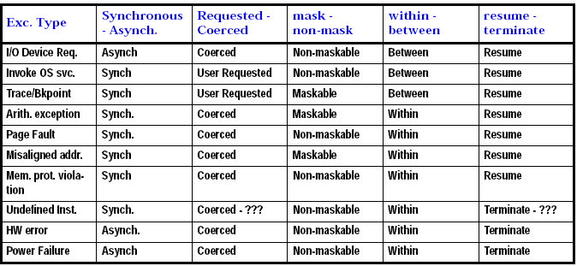
Five categories are used to define actions needed for different exception types

